Slide 1
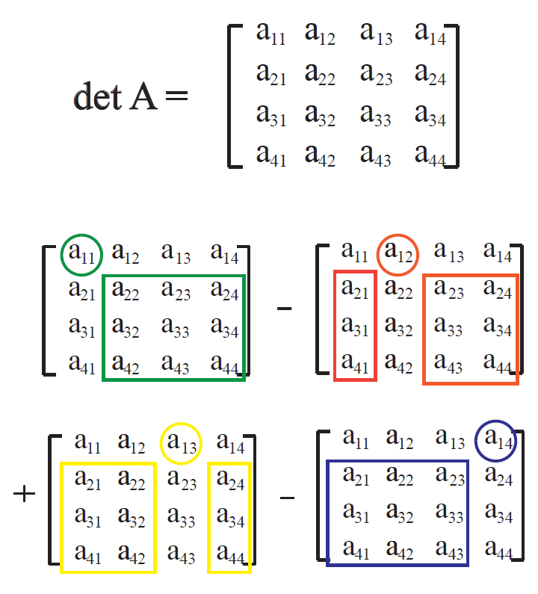
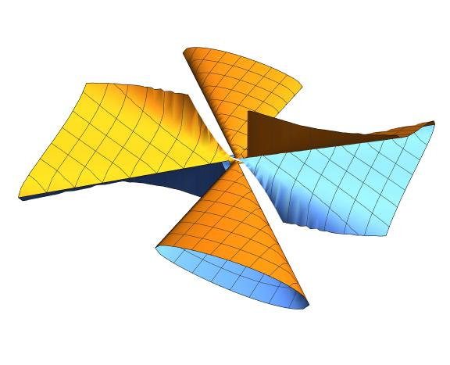
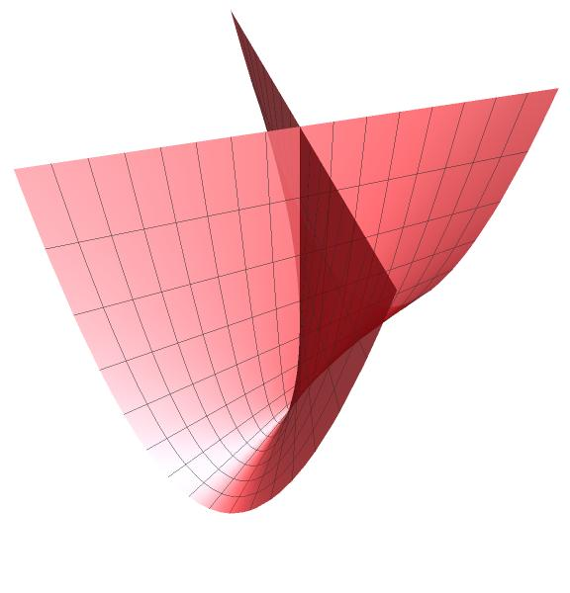
Preparing your poster for printing:
Go to File > Save As. Under Save as type (Windows) or Format (OS X), select PDF.
Open the PDF in Adobe Photoshop. Go to File > Save As. Under Format, select JPEG or TIFF. Choose a location and file name for your file and click Save. Click OK on the default save settings.
DO NOT SAVE TO A JPEG OR TIFF FROM POWERPOINT!
Fast Minors Computation of Functions of Algebraic Varieties in Macaulay2
Boyana Martinova, Marcus Robinson, Karl Schwede
Department of Mathematics, University of Utah
Introduction:
Finding Determinants Using Cofactor Expansion:
Computation Time Computation Time of 4x4 Minors in a 6x6 Matrix with Degree 1 Entries (non multi-threaded implementation) :
An algebraic variety is a geometric object defined by the set of solutions to a system of polynomial equations. A very well studied problem in algebraic geometry is determining where these geometric objects have singularities, or points where there exists some unanticipated behavior. By forming a Jacobian matrix of the system of equations and computing at which points that matrix has
rank r = v – d*, the singularities can be identified. One way to solve this equation is to compute the determinant of every submatrix of size r x r in the Jacobian matrix. Wherever the set of determinants of submatrices is equal to zero, a singularity is present.
* v = number of variables and d = the dimension of the geometric object
Evaluates n x n determinants by multiplying the entries in any row or column by the determinant of the sub-matrix (size n-1 x n-1) that is formed by the rows and columns in the matrix excluding those the entry belongs to.
The diagram to the right displays this process on a 4 x 4 matrix with cofactor expansion along the first row. As can be seen, the computation of det A does not require finding the determinant of all 3 x 3 minors, only those in boxes.
Examples of Common Algebraic Varieties:
Macaulay2’s default minors computation (using the Bareiss algorithm) is completely noncompetitive with our method. The difference in computation time increases as the number of variables increase. Notably, when the matrix has 10 variables per entry, our implementation was approximately 54 times faster.
Our non multi-threaded implementation still outperforms Macaulay2’s cofactor algorithm and is approximately 1.5 times faster at each iteration.
Results:
(Cone Over An Elliptic Curve)
(Whitney Umbrella)
Singular Locus
Explanation:
The Whitney Umbrella above is defined by xy^2 - z^2. The 1 x 1 minors in the Jacobian Matrix (y^2, 2xy, -2z) are exactly zero when y = z = 0. This line occurs in the diagram where things cross.
In order to extract the following data we:
Created a random matrix of polynomials given the size specifications.
Timed the amount of time it took to return the ideal of all determinants of minors of the given size for our implementation and Macaulay2’s existing methods (using Bareiss and Cofactor Strategy).
Repeated the timing three times and averaged the results.
Tested both multi-threaded and non multi-threaded versions of our implementation.
The mathematics software Macaulay2 is frequently used for such computations because it has all the functionality necessary to identify singularities of varieties, however the current implementation is not optimized and takes a long time execute. This is because
There can be a lot of minors to compute
The number of additions and multiplications can be very high
The default implementation finds determinants using the Bareiss algorithm which is efficient when the polynomials have a low degree and few variables, but very slow otherwise.
Conclusions:
Macaulay2’s current minors method proved to be efficient when the number of multiplications and variables is low, but by utilizing multi-threading and recursion, and minimizing the number of multiplications that occur, we coded a faster minors computation that outperforms Macaulay2.
Our code is yet to be complete. Macaulay2 complies in C++ and has additional pre-processing speedups. Ours is written in the scripting language. If we implemented it in C++, we would expect even faster results.
We hope to create a Macaulay2 package then write and submit a paper outlining our work to the Journal of Software for Algebra and Geometry.
Computation Time of 3x3 Minors in a 5x5 Matrix with Degree 3 Entries (multi-threaded implementation):
Methods:
The data shows that, over a randomly generated matrix, our multi-threaded minors method returned the ideal of 3 x 3 determinants twice as fast as Macaulay2’s cofactor expansion.
This percentage continues to grow as the number of variables increases.
We created a more efficient method for computing the ideal of all minors of size n in a given matrix, M. In order to do so, we coded a method in Macualay2 that:
Recursively finds all n x n minors by first computing and storing the 2 x 2 minors to be used in a cofactor expansion to find all subsequent sizes of minors until n is reached.
Only computes the necessary determinants at each step of the recursion.
Implements multi-threading so different computations can occur simultaneously in separate threads.
Acknowledgements:
I would like to thank Dr. Karl Schwede for helping me at every step of the process in creating this project, from formulating the idea to debugging the final code. Many thanks to Marcus Robinson for his contributions and constant support. Finally, a huge thank you ACCESS for funding this research and for this opportunity.

