Slide 1
Networks, Nukes, North Korea, and Knowledge or
How you might learn to stop worrying and love the bomb
Alexander H. Montgomery
Reed College, 2018-07-19

Slide 2
Outline
Network Structures & Mechanisms
Nuclear and other Arms Trade Networks
  Nuclear Smuggling v. Proliferation
  Nuclear v. Missile v. MCW
  Tacit Knowledge and Organizational Competence
  Implications
North Korea
  Puzzle: How did they succeed?
  DPRK Nuclear and Missile Capabilities
US Responses to DPRK
  Threats
  Nuclear Posture Review

Slide 3
Network Structures & Mechanisms

Slide 4
Nuclear Smuggling Networks
Hastings, Justin V. 2012. “The Geography of Nuclear Proliferation Networks.” The Nonproliferation Review 19 (3): 429–50. doi:10.1080/10736700.2012.734190.

Slide 5
Nuclear Proliferation Networks
Kroenig, Matthew. 2009. “Exporting the Bomb: Why States Provide Sensitive Nuclear Assistance.” American Political Science Review 103 (01): 113–133. doi:10.1017/S0003055409090017.

Slide 6
Nuclear, Missile, and MCW Networks
Arms Supply and Proliferation Networks (with David Kinsella), Oxford Handbook of Political Networks, ed. Jennifer Nicoll Victor, Alexander H. Montgomery, and Mark Lubell. Oxford University Press, Oxford, UK, 2017.
Notes:
Hymans: Micro – movitating scientists. Macro – leaving them alone.

Slide 7
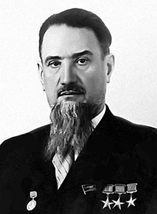
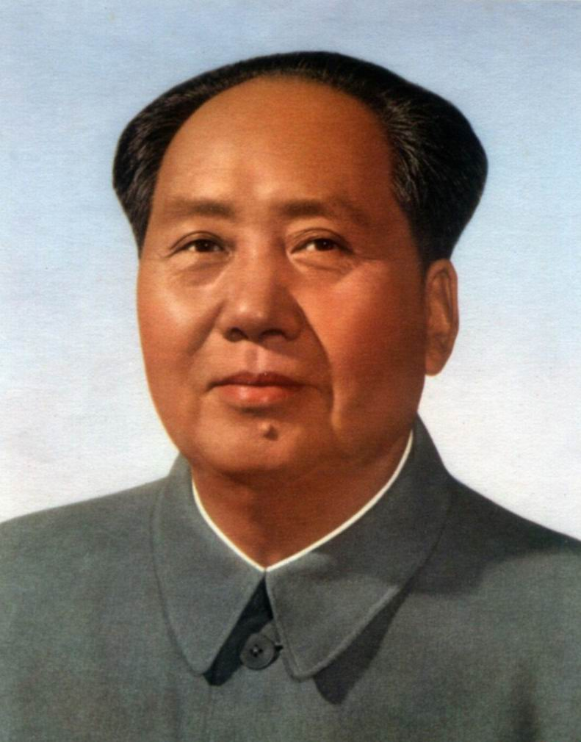
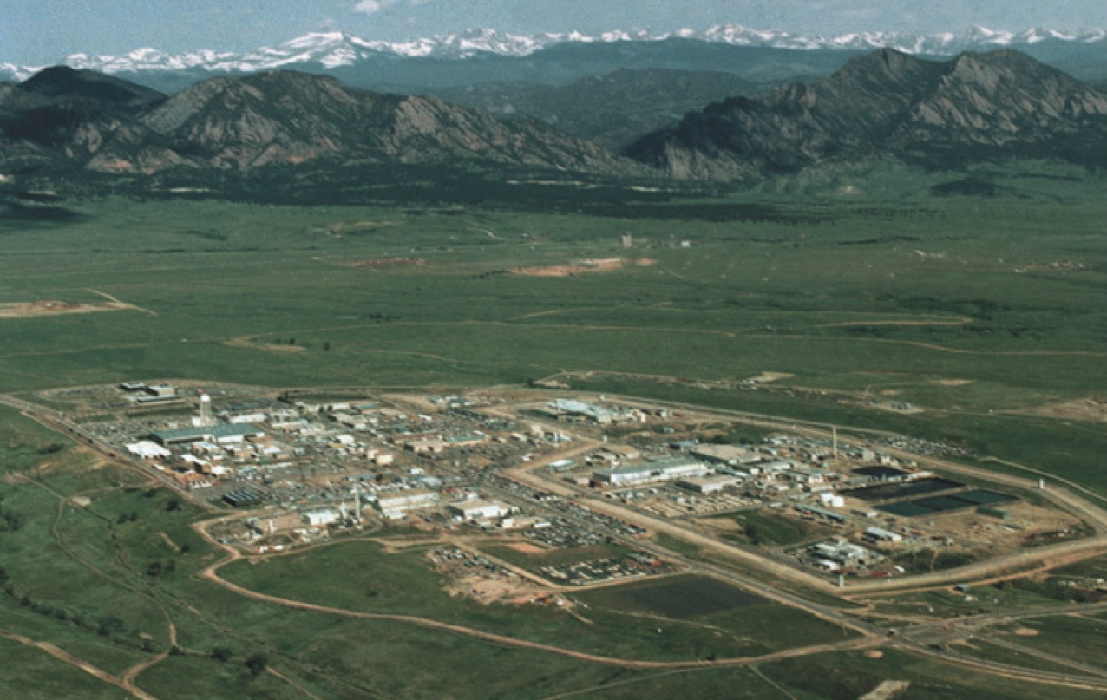
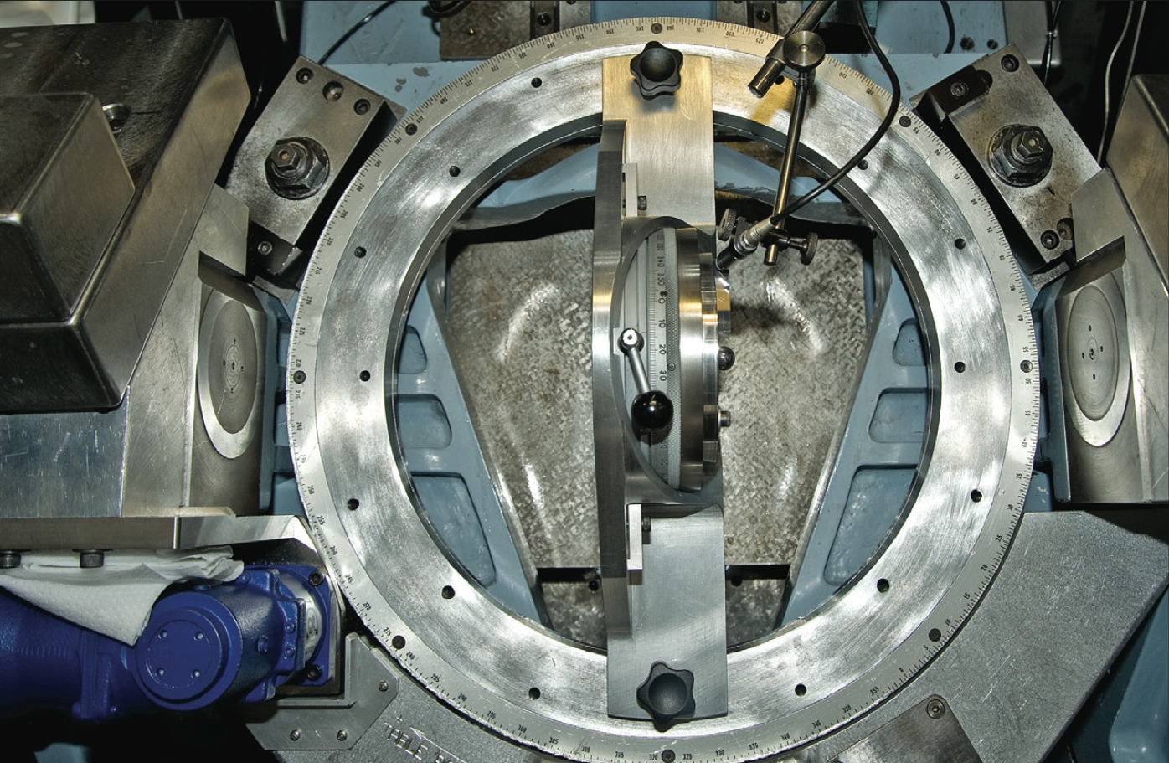
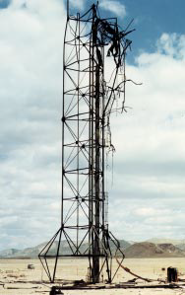
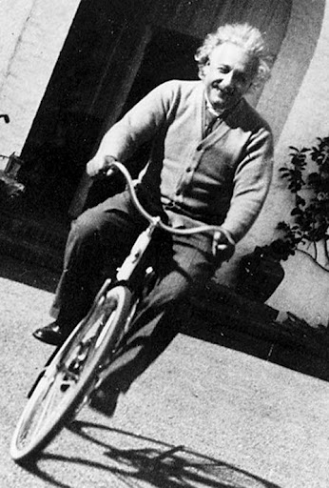
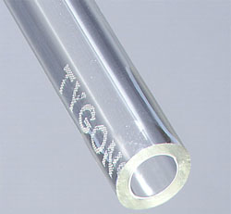
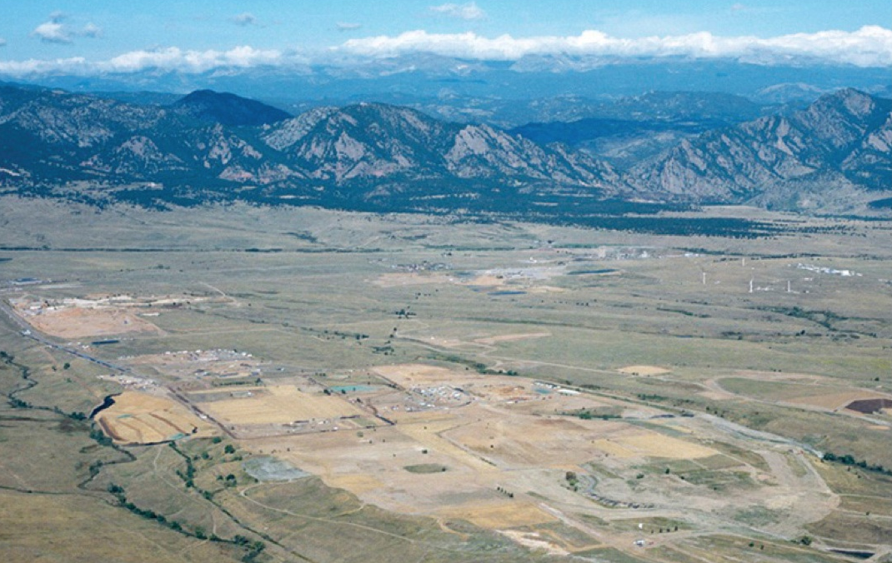
Answer 1:
Tacit Knowledge difficult to transfer
Tacit Knowledge (TK) required
TK difficult to create
Difficult to transfer even in-house
Neopatrimonial governing structures undermine production/transmission
…unless enclaves can be protected
Notes:
Three Knowledge Types
Explicit
Tacit
Tacit but Explicable
Tacit difficult to transfer even in-house
May be in groups, organizations, or nations
May not be aware of tacit components

Slide 8
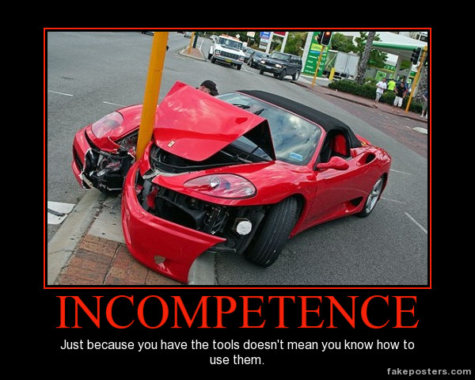
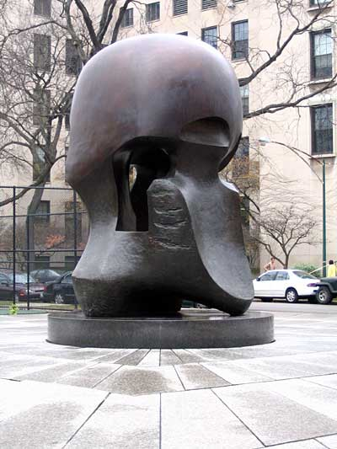

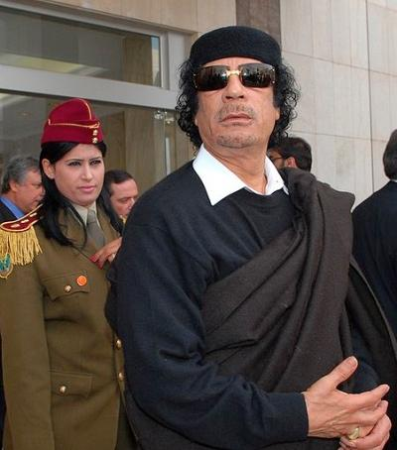
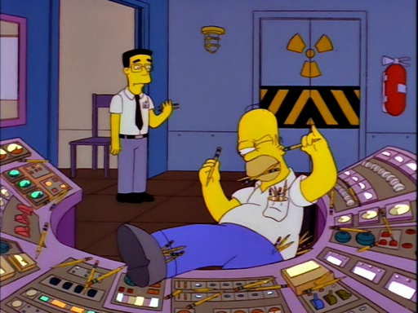
Answer 2:
Organizational competence affects transfers
Science/Technology infrastructure
Ability to manage Large-scale sociotechnical enterprises
Both undermined by Neopatrimonial governing structures…
…or simply organizational conditions that fail to reward competence.
Notes:
General determinants:
Good leadership
Individual motivation
Trust between workers
Locational proximity
Adequate resources ($$$ and national motivation)
Manhattan Project:
International collaboration
Scientist relationships
University environment
US/UK motivation to create a weapon to end the war

Slide 9
Implications
Counterproliferation Policy
  Proliferation Networks
  Cooperative Threat Reduction
Wider proliferation applications
  Bio has (some) similar characteristics
  Prioritize most plausible proliferation scenarios
David Kinsella and Alexander H. Montgomery. Arms Supply and Proliferation Networks. In Jennifer Nicoll Victor, Alexander H. Montgomery, and Mark Lubell, editors, The Oxford Handbook of Political Networks, chapter 33. Oxford University Press, 2017.

Slide 10
Puzzle: How did the DPRK succeed?
Explicit Knowledge
  Used to create Tacit Knowledge
Indigenization
  Juche!
Technology choices
  Pu, then HEU
  P2 centrifuge design
Parallel development
Determination and patience

Slide 11
Nuclear Weapon Types
Schroeer 1984, p.33, p.63

Slide 12

DPRK 2017 Test
http://www.armscontrolwonk.com/archive/1203852/sar-image-of-punggye-ri/
Notes:
http://www.armscontrolwonk.com/archive/1203852/sar-image-of-punggye-ri/

Slide 13
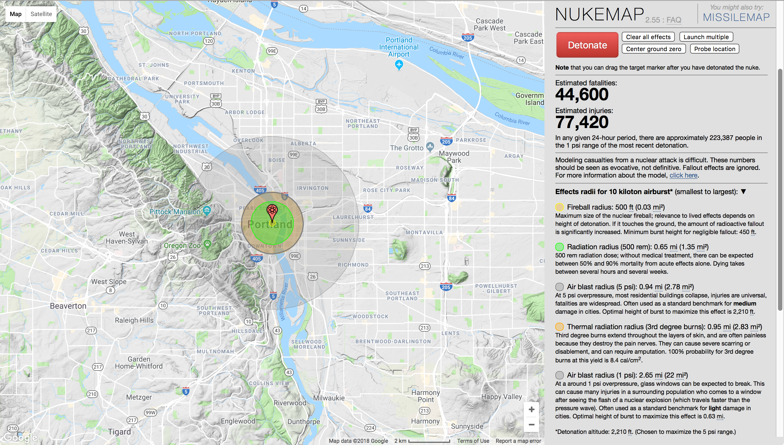
DPRK 2013 test (10 kt)

Slide 14
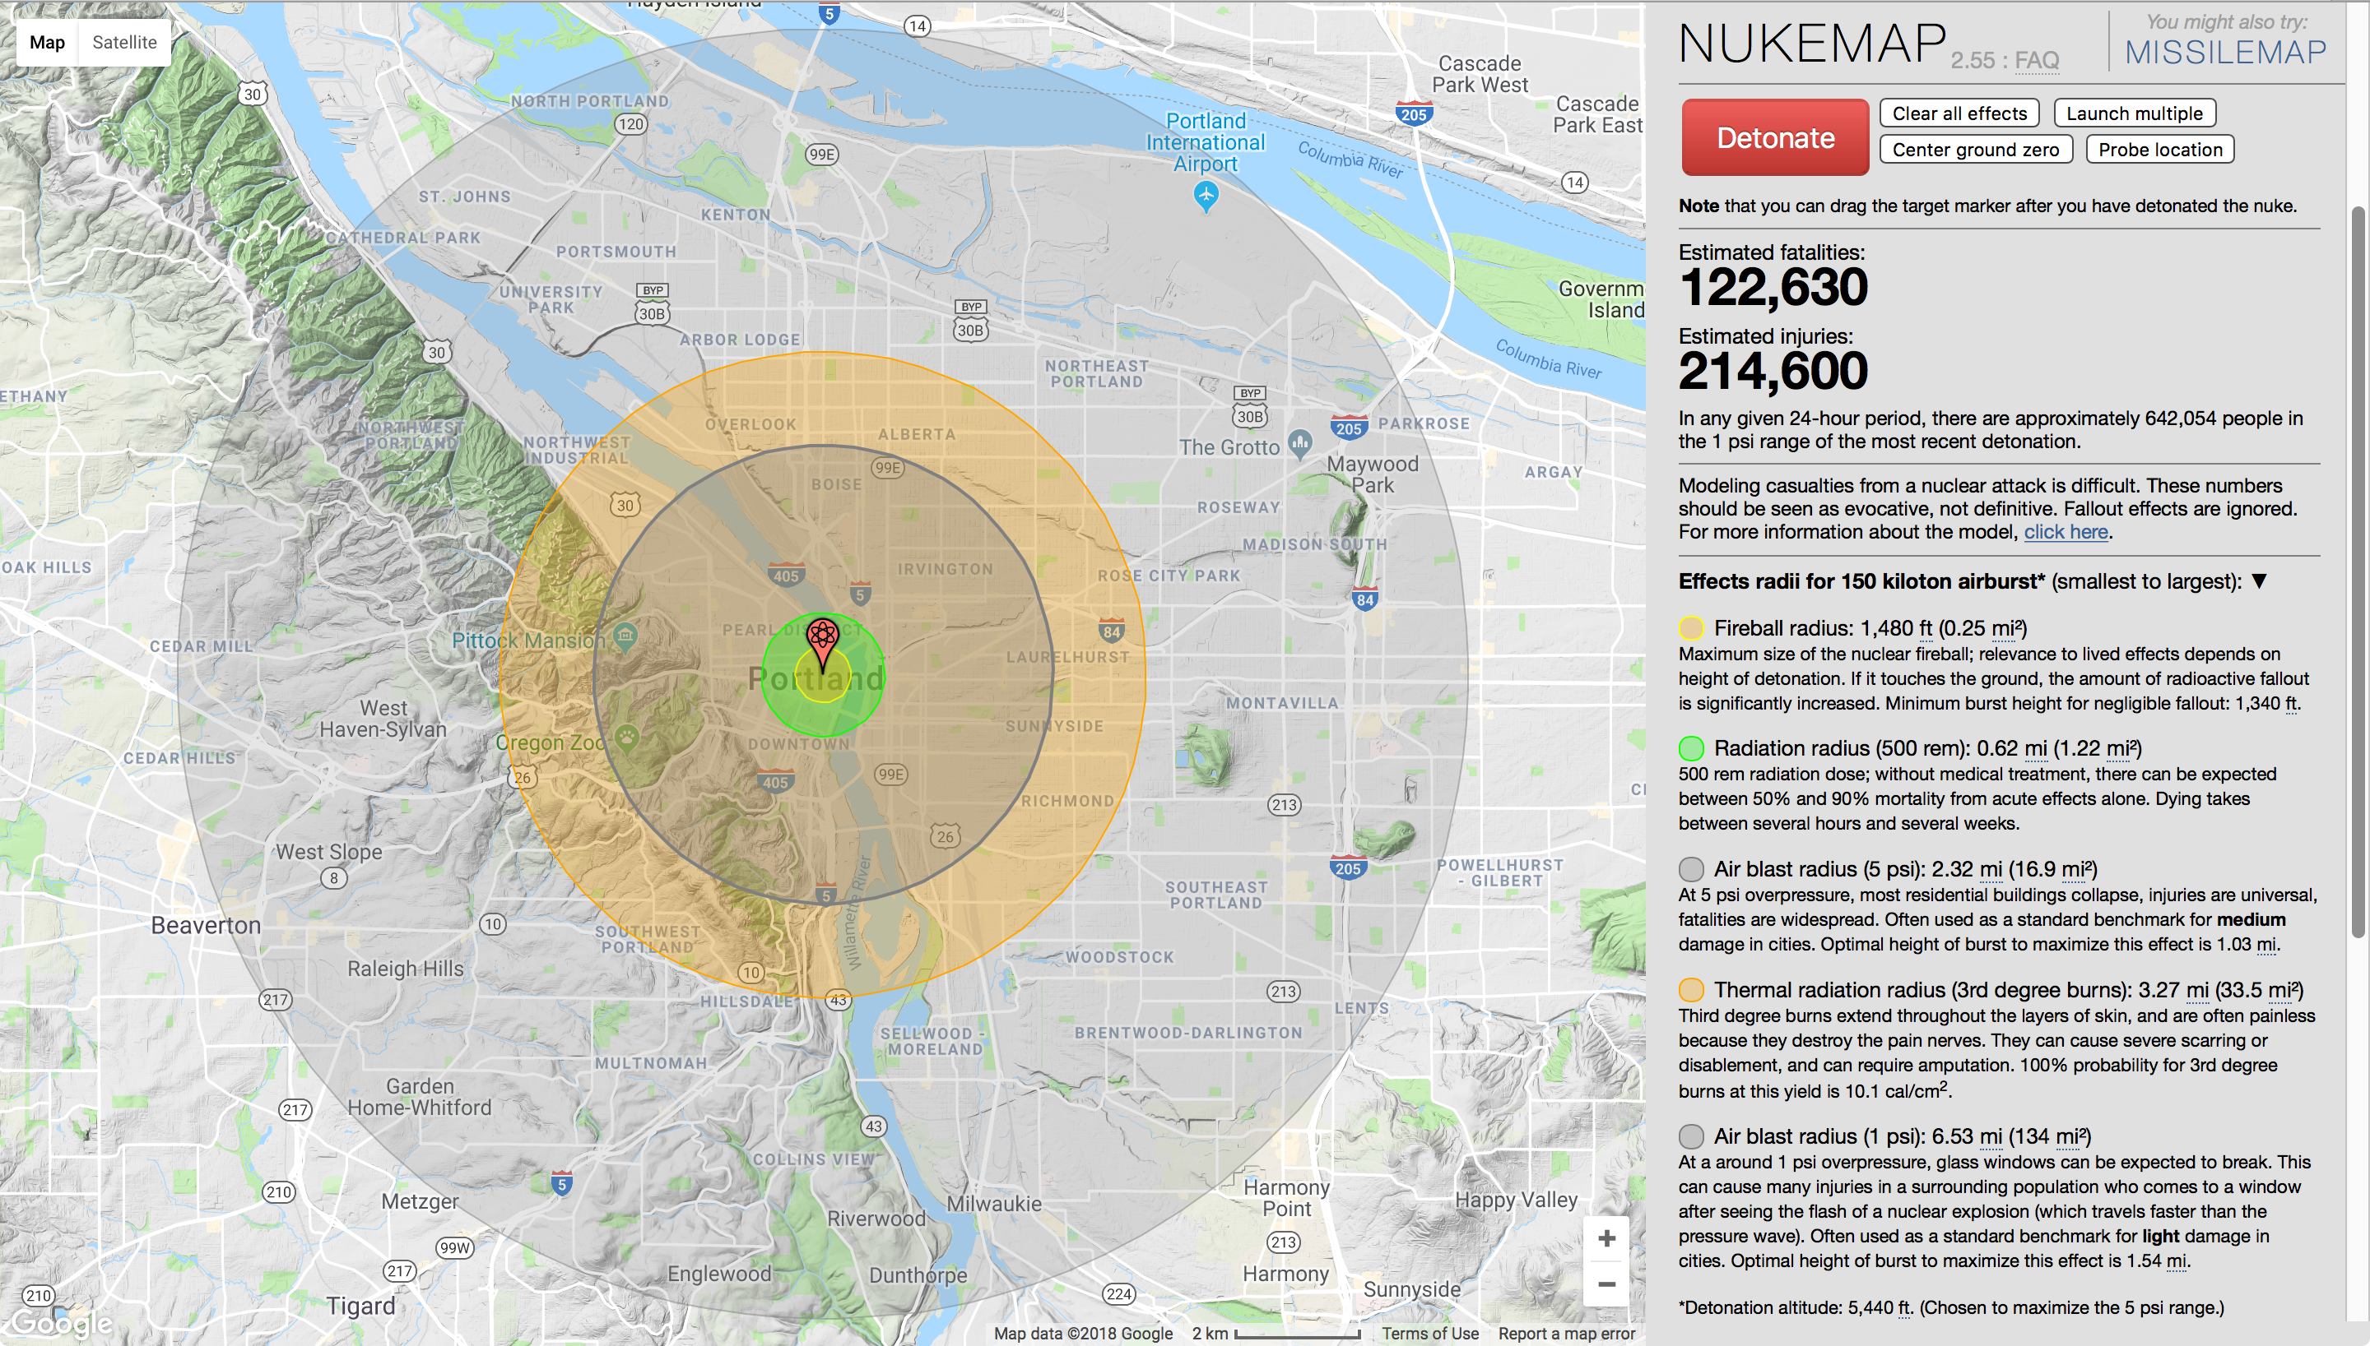
DPRK 2017 test (150 kt)

Slide 15
DPRK Missile Ranges
Notes:
Images:
http://www.isis-online.org/publications/iran/rampcomparison.html

Slide 16
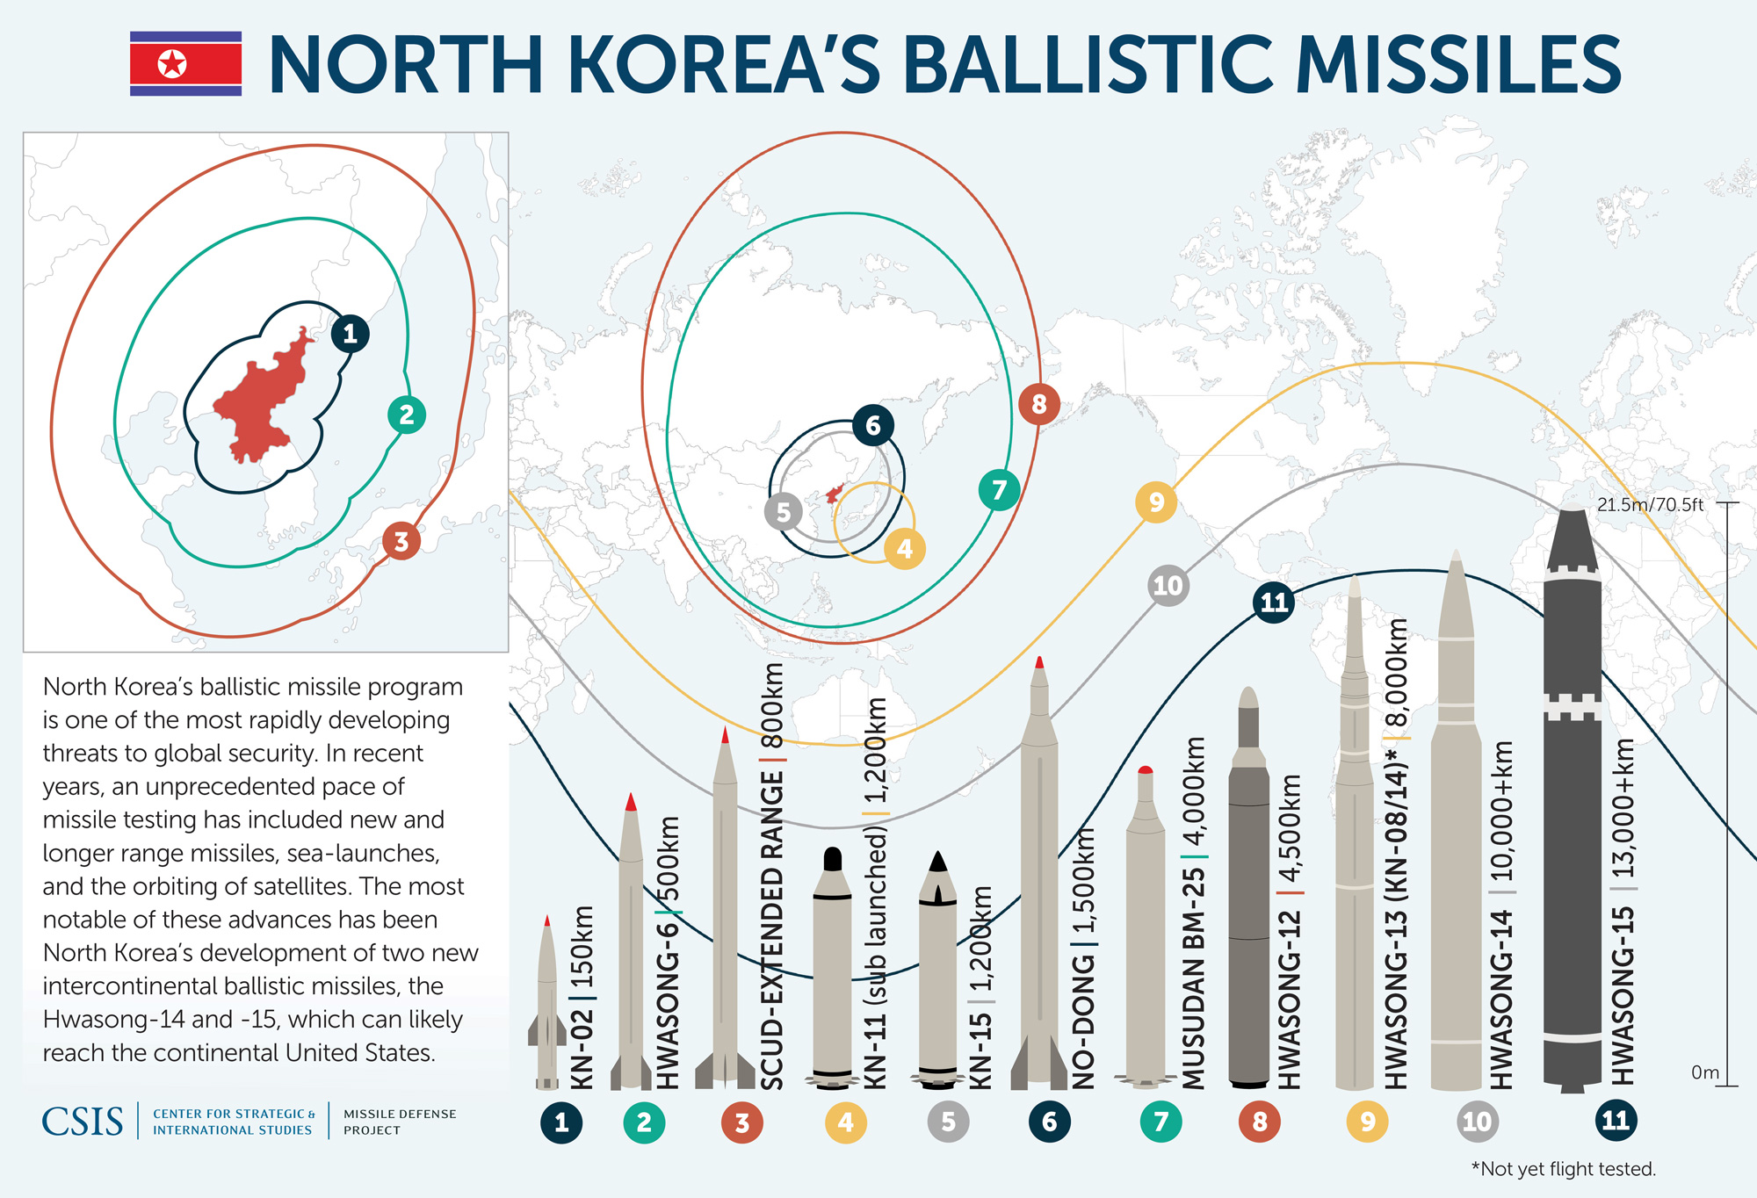
DPRK Missile Ranges
Notes:
Images:
http://www.isis-online.org/publications/iran/rampcomparison.html

Slide 17
DPRK July Launch
http://www.straitstimes.com/asia/east-asia/north-korea-claims-successful-icbm-test
Notes:
http://www.straitstimes.com/asia/east-asia/north-korea-claims-successful-icbm-test

Slide 18
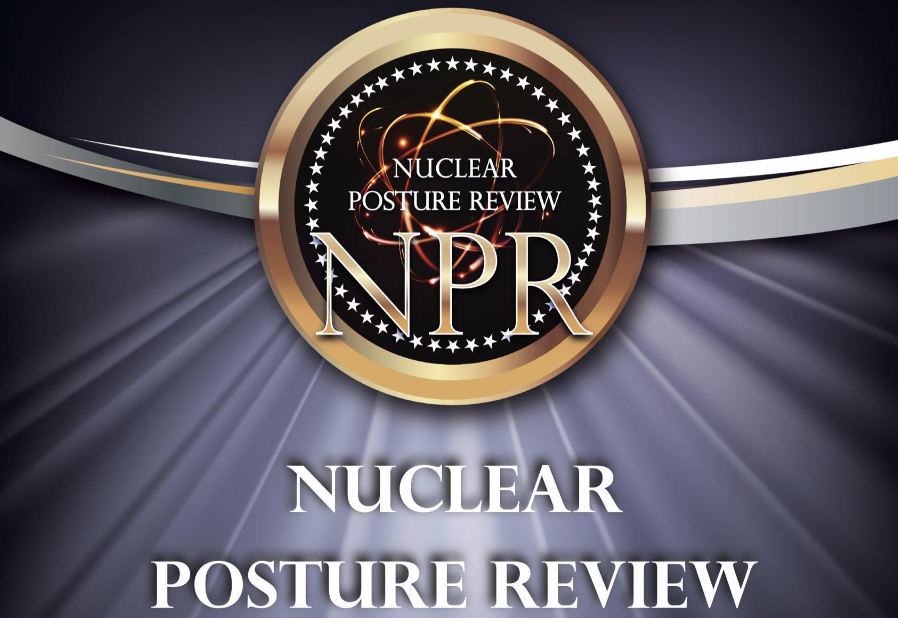

Slide 19
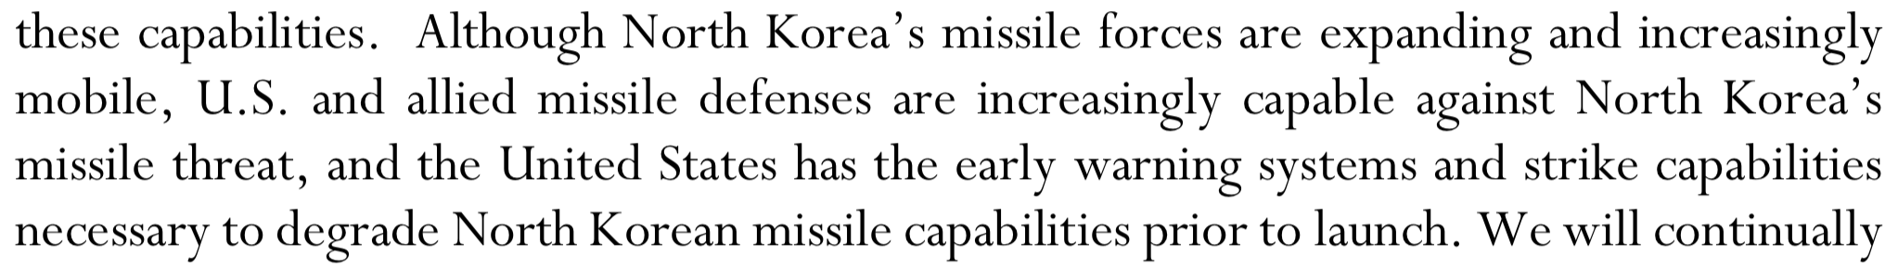
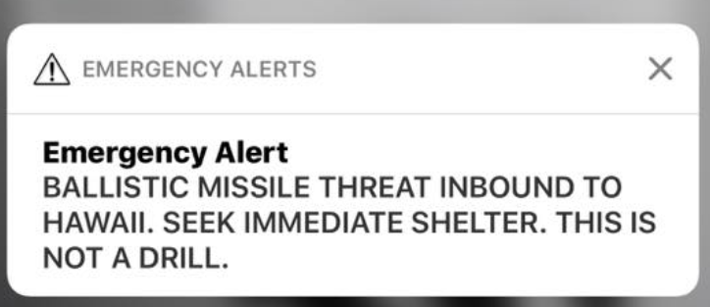
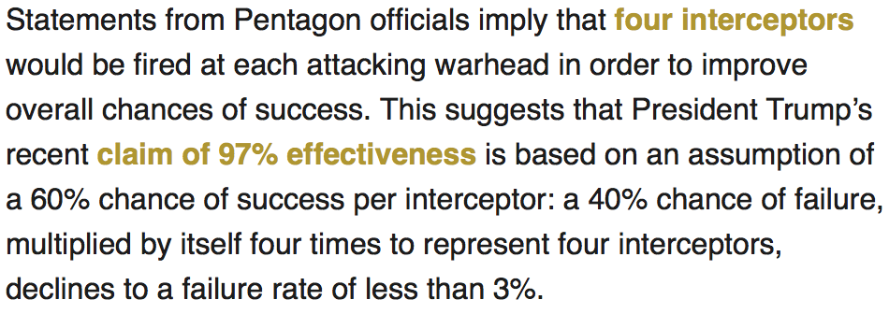
US Responses to DPRK: NPR
Nuclear Posture Review 2018, p.33
http://www.defenseone.com/threats/2017/09/if-north-korea-fires-icbm-us-might-have-shoot-it-down-over-russia/141376/
http://www.defenseone.com/ideas/2017/10/us-missile-defense-north-korea-icbm/141866/

Slide 20
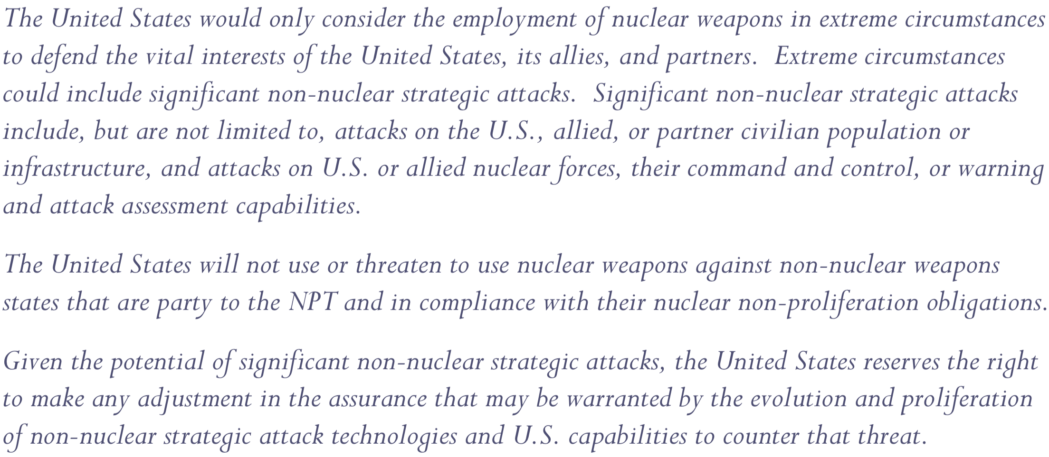
US Responses to DPRK: NPR
Nuclear Posture Review 2018, p.21

Slide 21
Conclusions
Networks + Nukes
  Help is not always helpful
  This is due to TK and organizational constraints
North Korea
  Autarky has its benefits
  Protecting a technical enclave leads to better decisions
  Trying hard for a long time works
US Policy
  Don’t make bad threats
  Accept reality
  Focus on prevention
  Buy duct tape?
Notes:
http://www.ct.gov/dph/cwp/view.asp?a=3115&q=482598

Slide 22
Questions?

