Slide 1
“Min Irhabi?”
Who’s a terrorist?

Slide 2
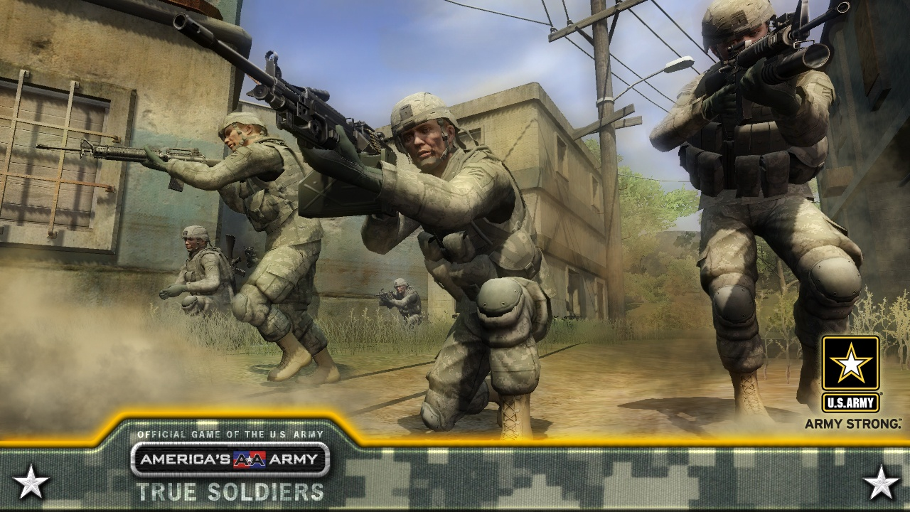
Representations of military orgs
America’s Army
al-Quwat al-Khasa 2
America’s Army

Slide 3
What do militant organizations do?
Produce violence
Gain, control, and defend territory
Offensive violence (rocket attacks, bombings, sabotage)
Terrorist tactics (targeting civilian installations, kidnappings)
Guns for hire (state sponsorship, mercenary activity)
Engage in peaceful/licit politics
Political bureaus
Judicial systems
Diplomatic apparatuses
Demonstrations, protests, strikes
Provide protection and representation
Maintain local order
Provide political leverage to marginalized groups
Engage in advocacy
Photo by Annasofie Flamand

Slide 4
What do militant organizations do?
Provide services
Healthcare
Education
Childcare
Welfare
Infrastructure
Social and cultural life
Publications
Festivals/holidays
Sports/scouts
Historical production
Performing and fine arts
Poetry and literature
Photo by Sarah Parkinson
Economic efforts
Licit: Industrial operations, bureaucracy, taxation
Illicit: Drug trade, money laundering, resources, kidnapping for ransom, extortion/taxation

Slide 5
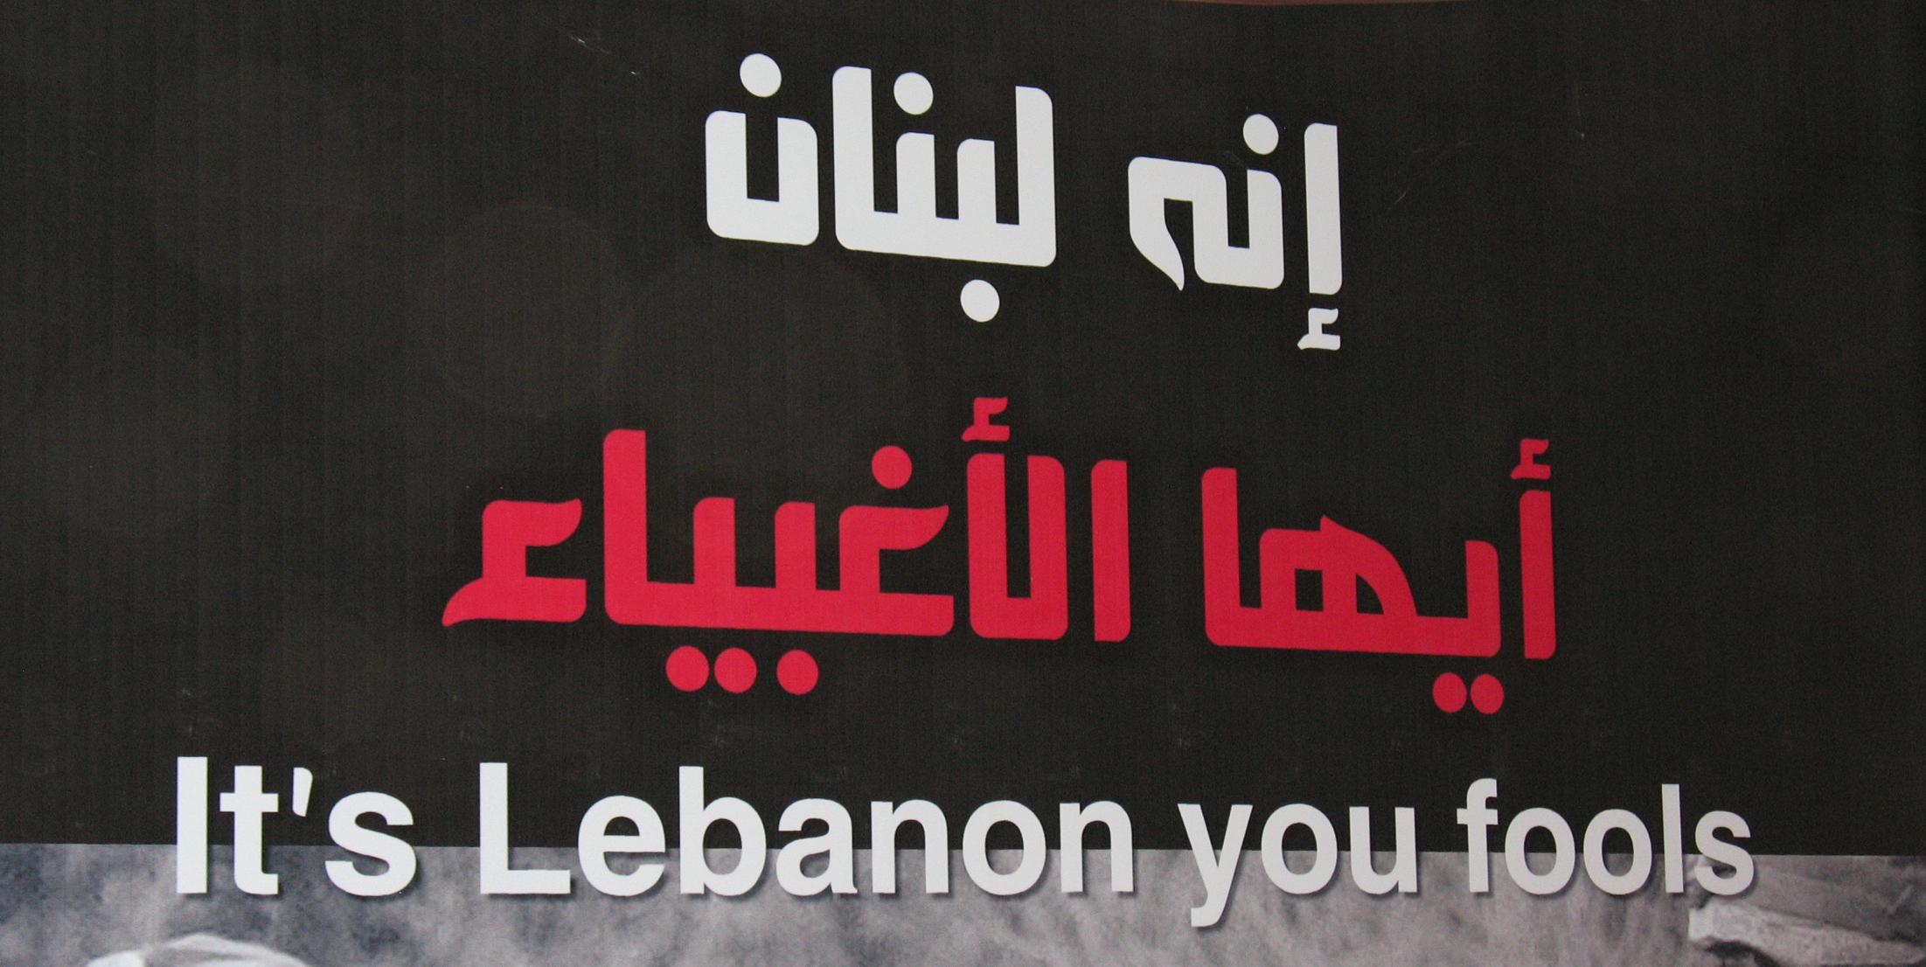
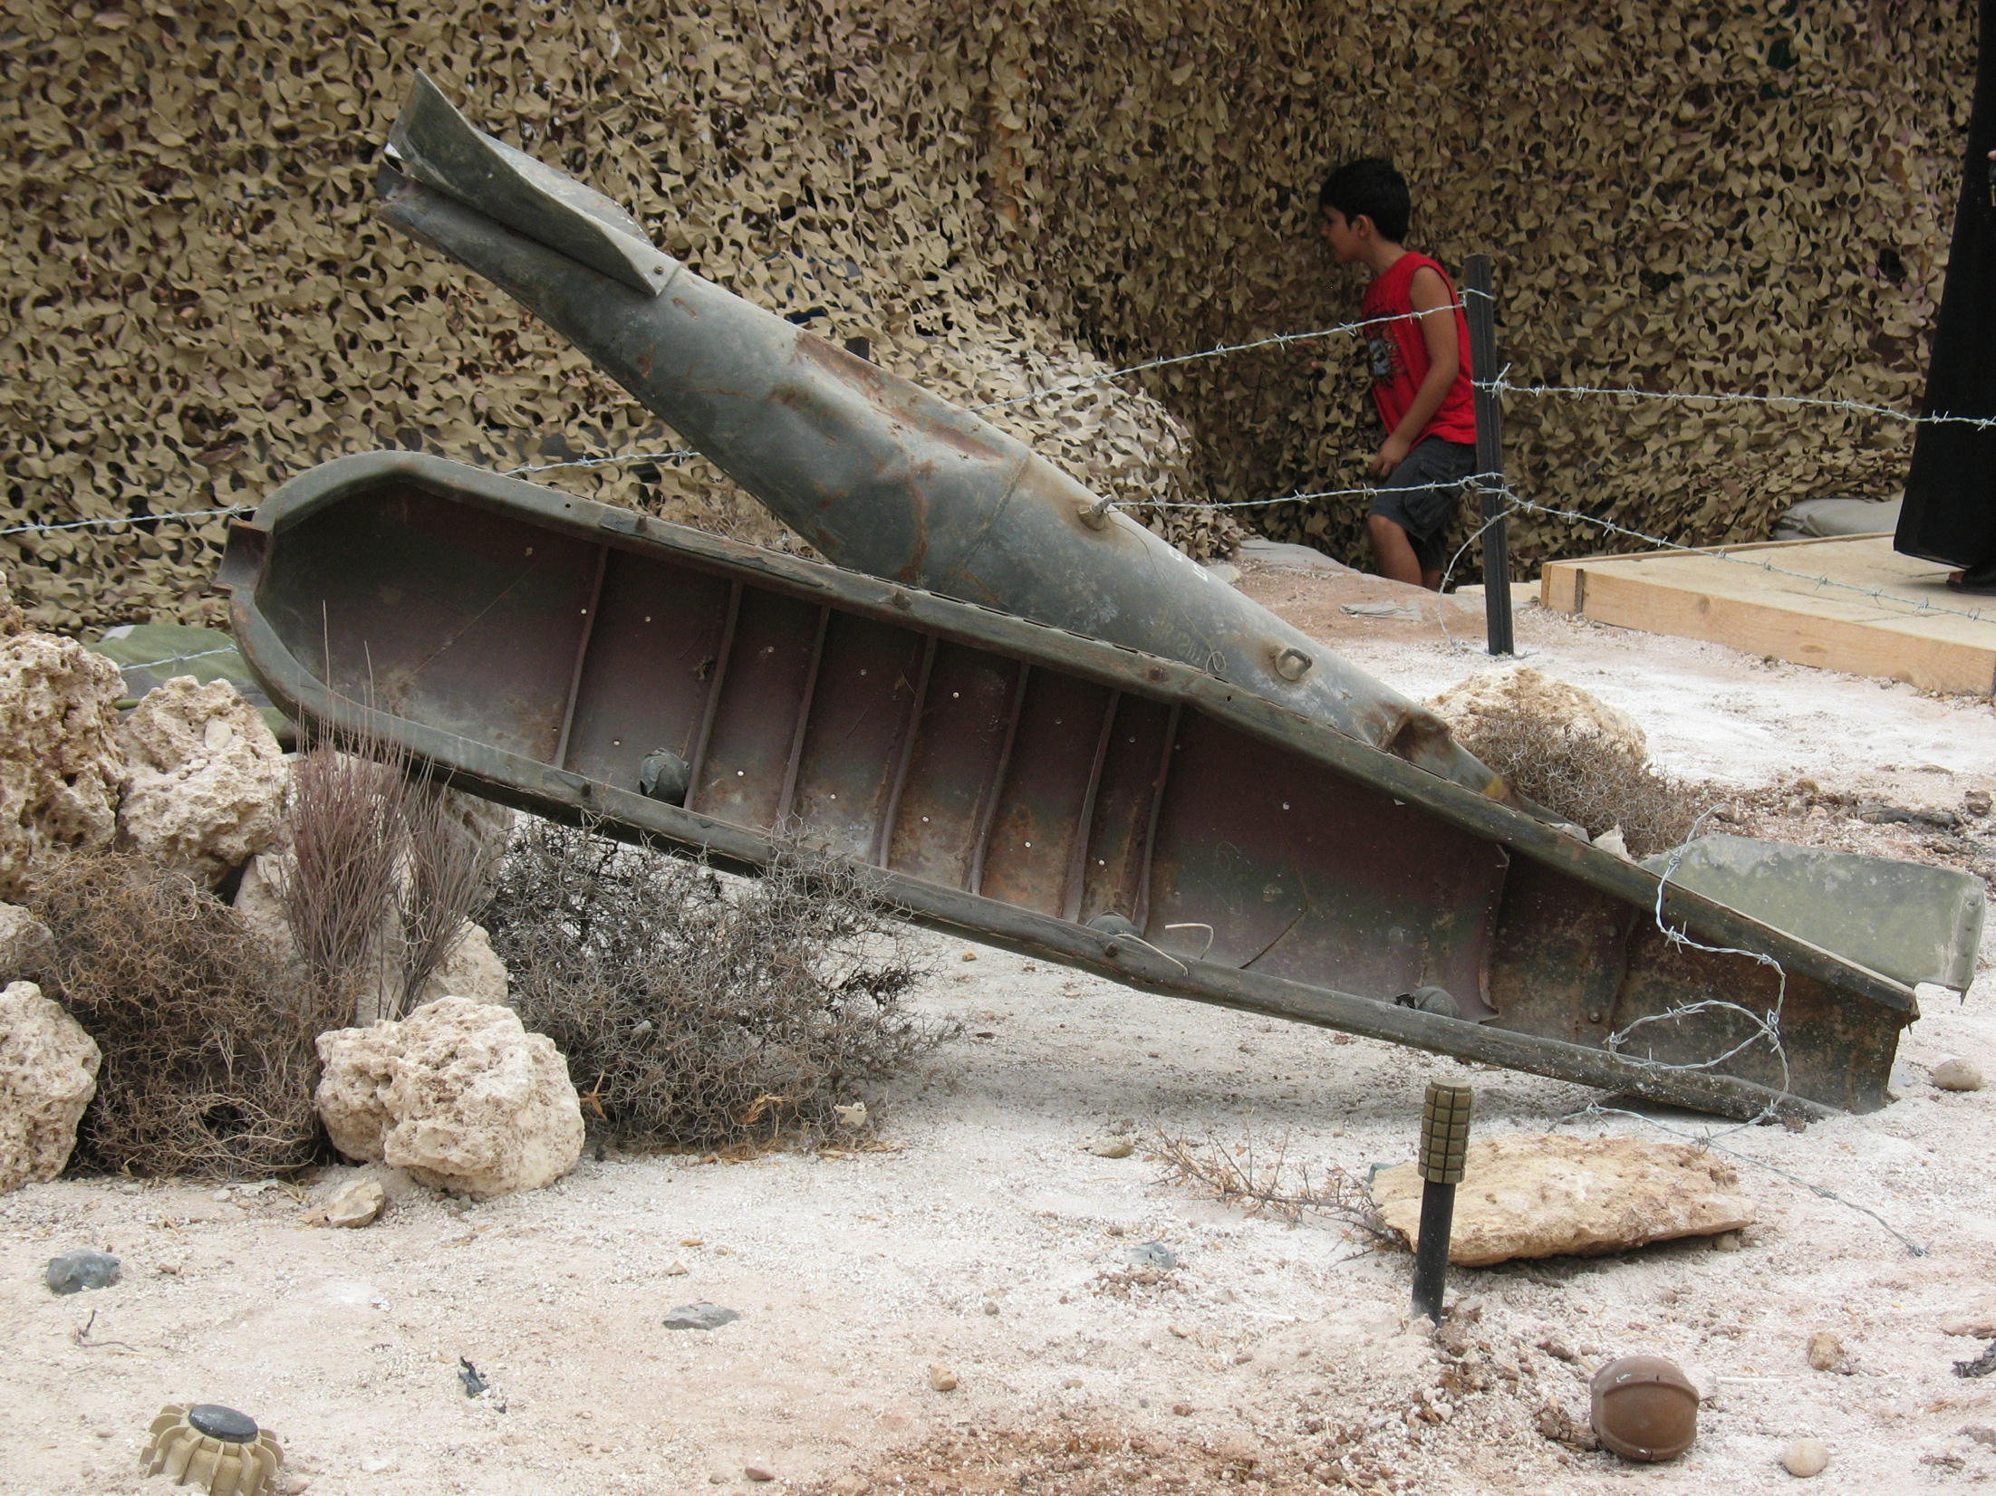
Hizb Allah and Cultures of Memory
Counterclockwise from top left: Model of a Hizb Allah bunker in South Lebanon, poster from Bayt al-’Ankabut, recovered cluster bomb shell, preserved cell in Khiam Prison. Photos by Sarah Parkinson

Slide 6
The politics of naming
Idea of caricature (Harb and Leenders 2005)
What caricatures can we think about in Middle East politics?
Suicide in Islam
Prohibition founded predominantly in hadith
Distinctions in terminology:
“Suicide bombing” or “suicide terrorism”
“Self-martyrdom,” “martyrdom operations,” or “self-sacrifice”
Idea of defensive war
Jihad (also see hadith regarding battle)
“The best fighting (jihad) in the path of Allah is (to speak) a word of justice to an oppressive ruler” (Abu Dawud, Book 37, Number 4331)
This is why many Middle East specialists find the term “salafi jihadis” problematic

Slide 7
Why do individuals participate?
Early work: Much of it is based in old scholarship on criminality and social deviance.
Idea that people who engage in violence and particularly terrorist attacks are deviant, damaged, or psychologically different
What assumptions about violence undergird this approach?
Profiling
Religion/fanaticism: Fanatics engage in terrorism
Motivation
Brainwashing
Poverty (personal or group)
Relative deprivation
Resentment
Sometimes combined with an access to education argument

Slide 8
But…
Asad encourages us to contemplate intention rather than motive (42)
Pape finds that secular groups use suicide bombing more than religious groups (though the numbers have changed in recent years)
Tessler and Robbins (2007) discount religion as a source of support
Muslims in general “appalled that violence is committed in the name of Islam” (Tessler and Robbins p. 307, citing Esposito 2002)
Also, many of these studies usually focus only on those who participate directly in violence rather than members of a military group or supporters of a militant organization (Parkinson 2013)

Slide 9
And…
Role of public opinion and public support (Tessler and Robbins 311)
US foreign policy (definition of terrorism, Israel/Palestine, Iraq, and, now, drones)
National governments
People often switch groups over time
So…what determines public opinion and thus public support for terrorist attacks?

Slide 10
A twist…
Source

Slide 11
Terrorism, terrorists, terror…
Tessler and Robbins (2007): “…[T]he term has strong political and normative connotations. For purposes of the present study, "terrorism" refers to politically motivated violence against noncombatant members of an "enemy" community; that is, action or threatened action that seeks to kill or injure civilians with the goal of altering the policies or behavior of the community to which the civilians belong.” (325, Note 1)
Pape (2003): “Terrorism involves the use of violence by an organization other than a national government to cause intimidation or fear among a target audience” (3)

Slide 12
The two big questions
Who counts as a non-combatant or civilian?
Colonists? Settlers?
Think back to Battle of Algiers
Members of an occupying authority?
Police
Merchants
Contractors
Non-military intelligence
Can we call a group “a terrorist organization” if both the corporate entity and its members are engaging in all of these other activities?
SSNP commando Sana’a Muhidilii
(Photo by Sarah Pakrinson

