Slide 1
Opening Remarks
Iranian Delegation
19 November 2010

Slide 2
“In the nuclear field, our purpose has nothing to do with nuclear weapons, nor would this technology ever be diverted into making weapons.”
-- Ayatollah Ali Khameini

Slide 3
“Allah is with those who restrain themselves”
--The Qu’ran, Chapter 16, Verse 128

Slide 4
“Many other countries are enriching uranium without the world making any fuss about it.”
-- Former IAEA Director General Mohamed ElBaradei

Slide 6
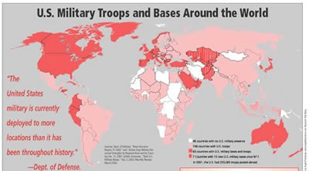

Slide 7
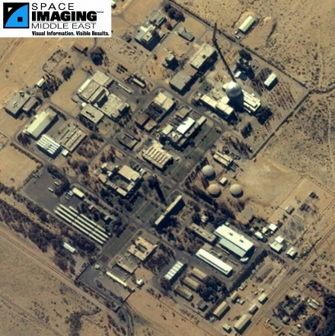
Image of a nuclear research center for the bloodthirsty Zionist Entity, 2009

Slide 8
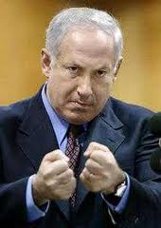
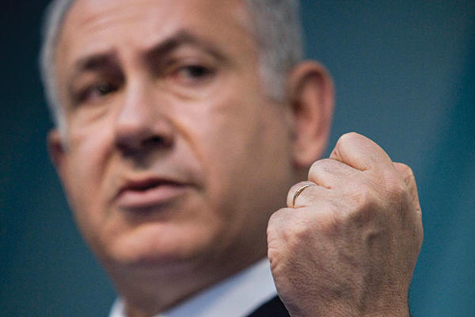
Benjamin Netanyahu, Zionist oppressor

Slide 11
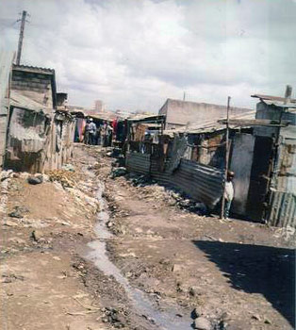
Slum in Tehran, Iran, due to imperialist Western sanctions

